Slide 1
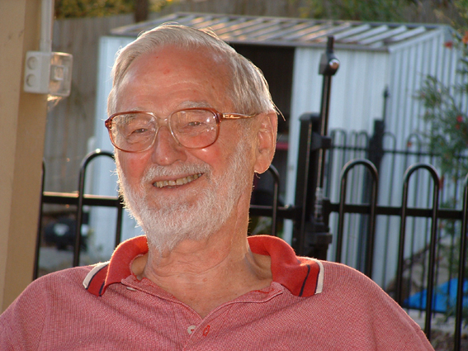
Clive Rainsford Henderson

Slide 2
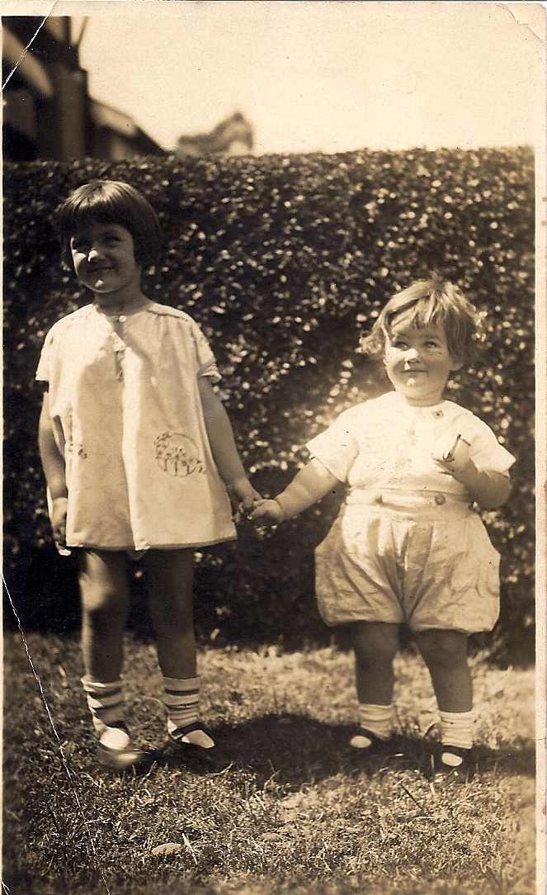
Notes:
Sister and brother, Beth and Clive.

Slide 3
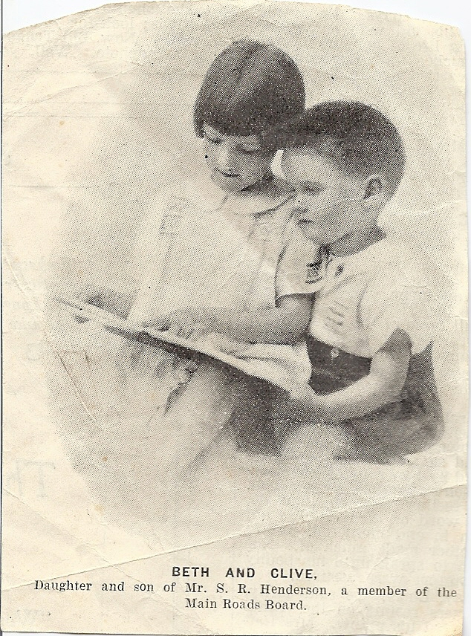
Notes:
From the local newspaper: Beth and Clive, daughter and son of Mr S. R. (Stanley Rainsford) Henderson, a member of the Main Roads Board of New South Wales.

Slide 4
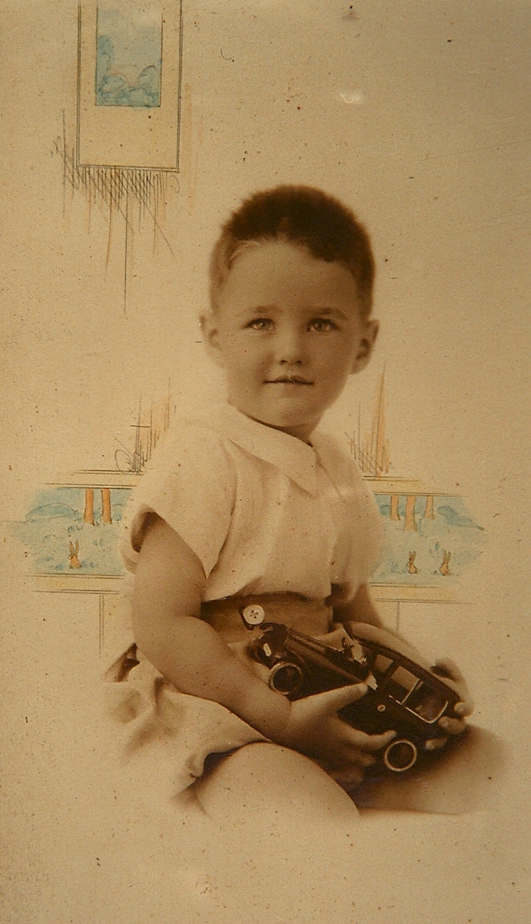
Notes:
Studio photograph – Clive holding a model car.

Slide 5
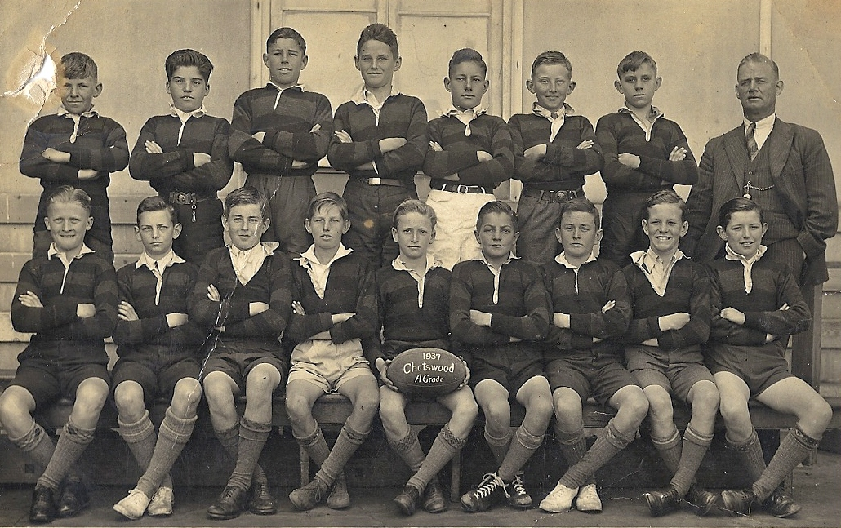
Notes:
A Grade football, Chatswood Primary School, Sydney, 1937.
(Back row, fourth from the left)

Slide 6
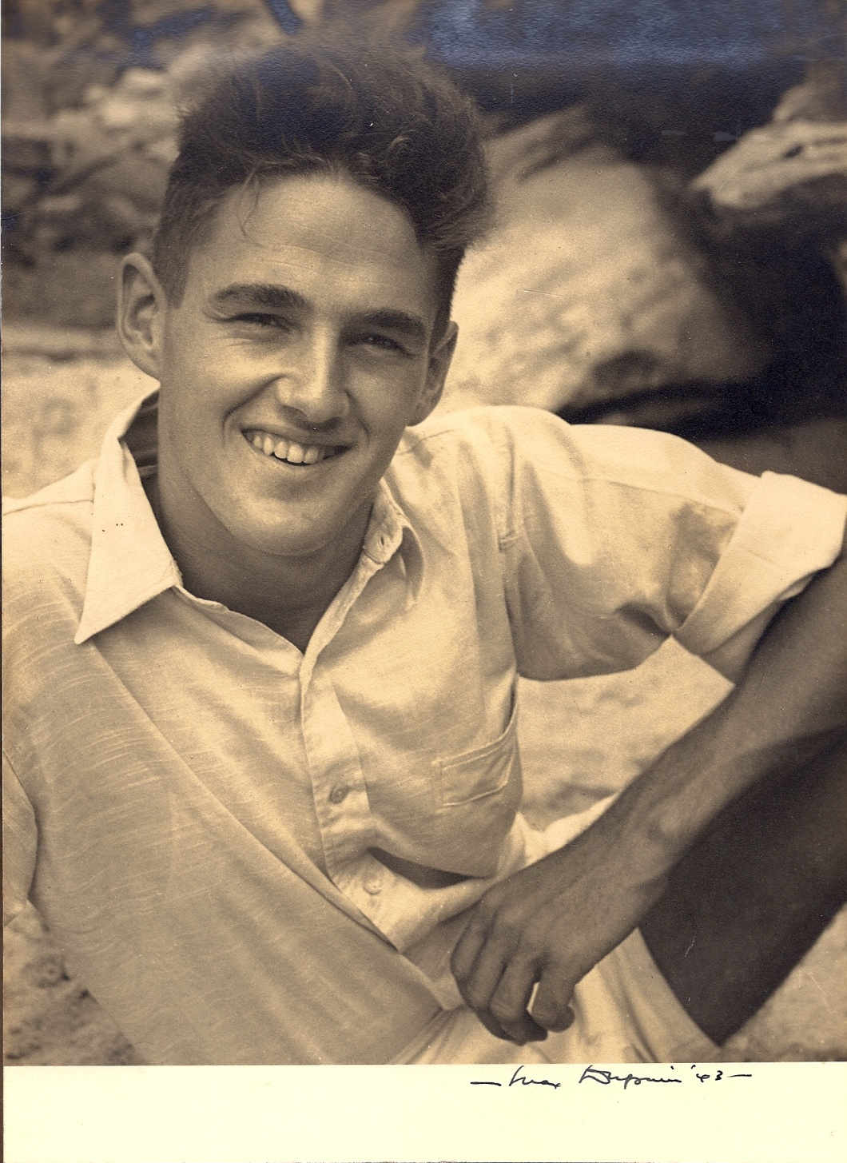
Notes:
Photo of Clive by renowned Australian photographer Max Dupain, taken in 1942 shortly before Dad enlisted in the RAAF. Clive and his sister Beth were both friends of the Dupains who also lived at Longueville on the shores of Sydney Harbour.
Clive and a big group of friends including the Dupains spent every minute they could sailing on the harbour.

Slide 7
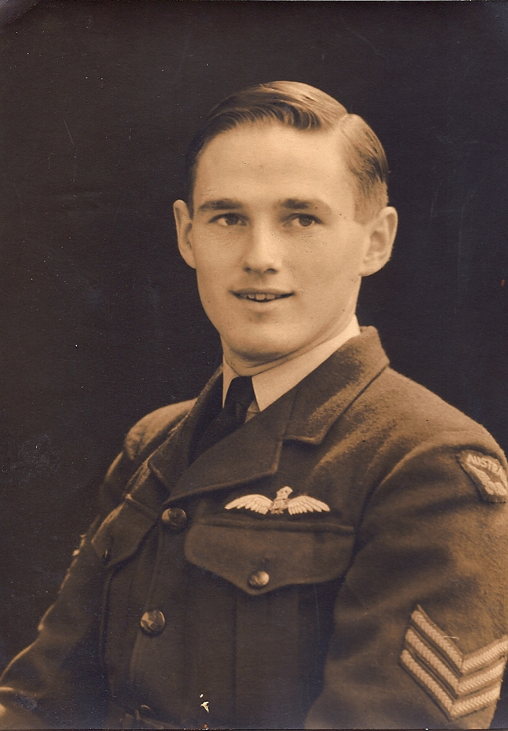
Notes:
Clive was passionately single-minded about joining up with the Air Force as soon as he could – and he did.

Slide 8
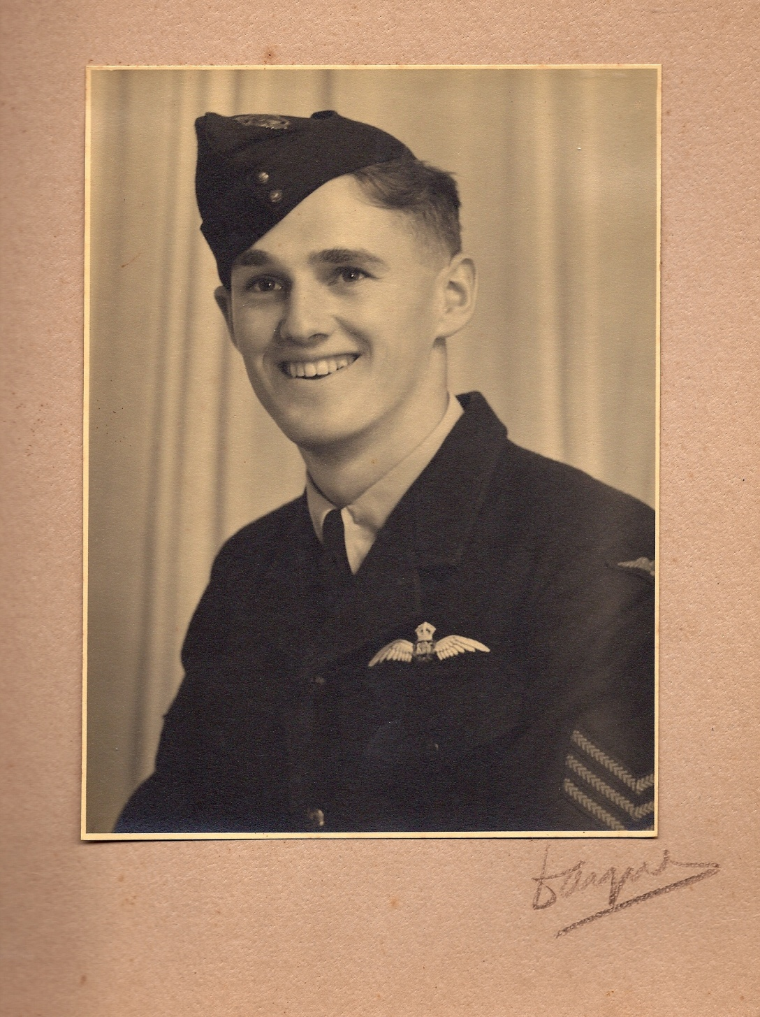
Notes:
Clive in uniform.

Slide 9
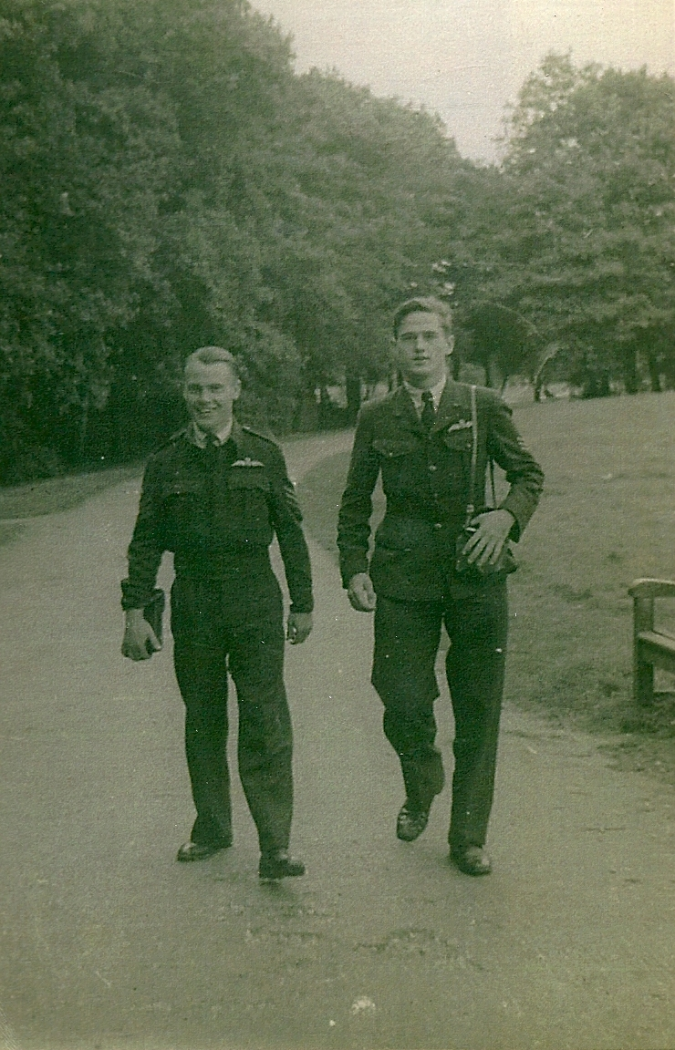
Notes:
With good friend and fellow officer Peter Clements during training in England.

Slide 10
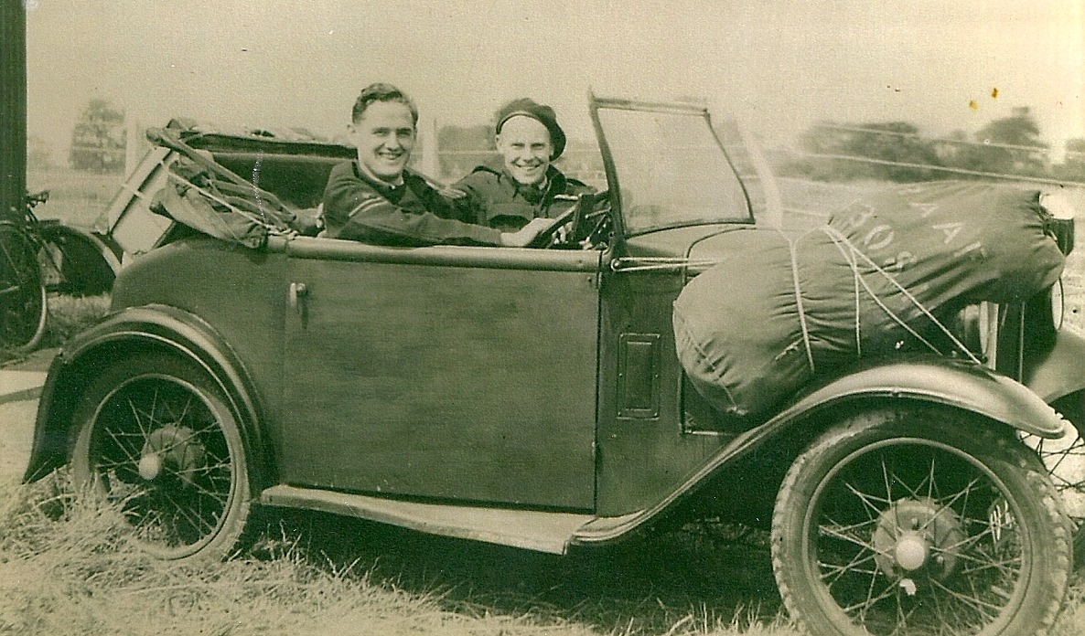
Notes:
Clive and Peter Clements head off on a jaunt with kitbags tied to the front mudguard of the car (Ford?) they bought together to get around Britain during their days off. Such good times they had.
Clive and Peter remained firm friends for the rest of Clive’s life. Peter went on flying after the war. If family member’s memories are correct, his piloting included flying private customers on jaunts to the Antarctic.
If you’d like to connect with Clive and Peter again decades later.

Slide 11
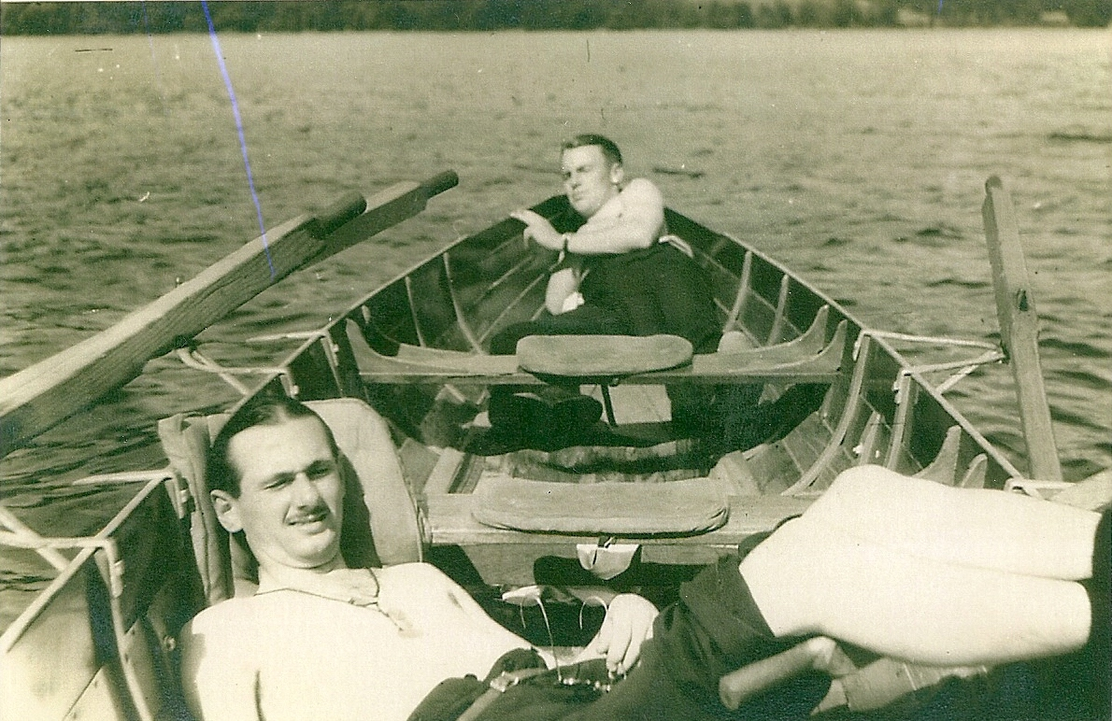
Notes:
Time off – in a boat of course – with the fellas catching every bit of sunny warmth the English weather can offer. Photo taken by Clive who was relaxing as well as indulging in his love of photography.

Slide 12
Notes:
Clive trained in Wirraways during his RAAF days, and over the decades has maintained a deep love of all things flying – and especially planes from earlier years.
A few years ago, Clive accompanied son-in-law Keith to the nearby Caboolture Air Museum (north of Brisbane) to see an advertised display of vintage planes. While there, they were both tickled to find a couple of Wirraways including… the exact plane that Dad had flown in!!
This photo shows those same Wirraways flying nearby over the Sunshine Coast coastline. We’re not sure which one is the one, however both are gorgeous, no doubt you’ll agree. We imagine Clive in the pilot’s seat.
For more WW2-related stories, slides 77 – 79 in this presentation for a reference to Clive’s major research project into the circumstances surrounding the death of Nancy’s brother Colin, WW2 pilot whose Lancaster had crashed in Foxton, England.

Slide 13
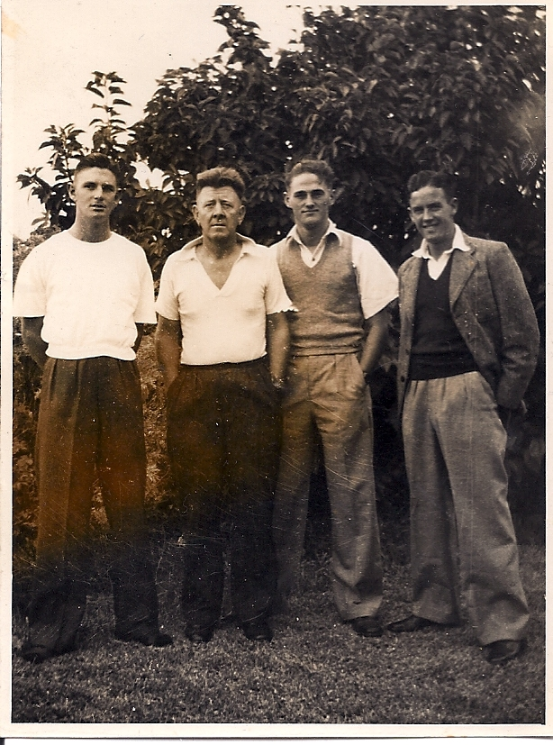
Notes:
Back in Australia catching up with friends.
Definite: Clive is third from the left.
Pretty sure: Fourth from the left is Clive’s very good mate John Gilkes (pronounced Jilks) whose family had the 32 footer their group of friends so loved sailing on Sydney Harbour every minute they could.
Maybe: On the left in white, is that Mr Chapman and his son who also loved sailing?

Slide 14
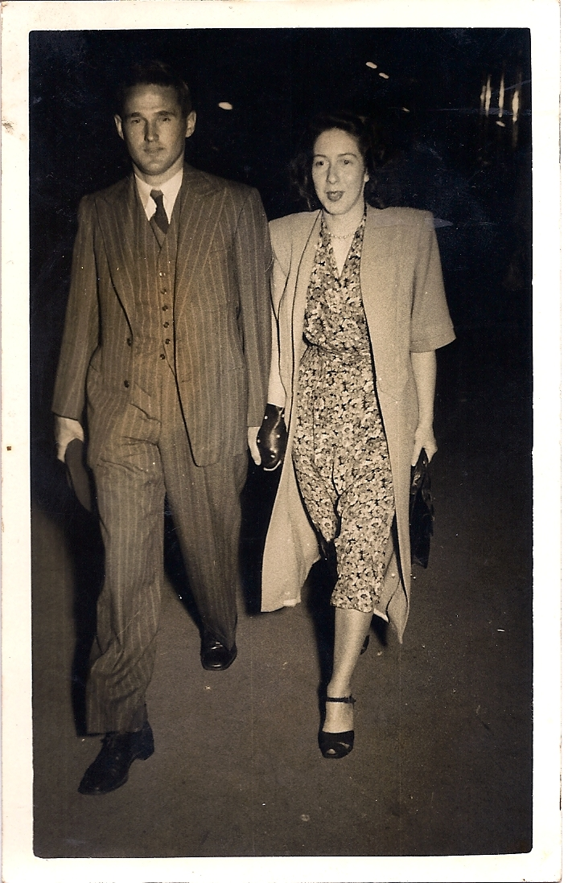
Notes:
Clive and Nancy before they were married, going out together after work. When WWII finished, Clive returned home to Sydney. Soon after he began working with Hastings Deering (who sold Caterpillar and John Deere tractors). Clive stayed with that same company for his whole working life until his retirement.
Nancy had come back down to Sydney from her family property in western New South Wales. She was living in a boarding hostel and working in a bank in central Sydney. They were engaged for two years before marrying.
Clive and Nancy met at a wedding where Clive knew the groom’s family, and Nancy knew the bride’s family. The treasured family story, which we asked to be told to us many times, was that Clive had seen a hat across the other side of the church and decided then and there that he wanted to meet and marry the woman under that hat. From then it was history. They began dating when they could, given the very strict visiting and outing rules of Mum’s boarding house. Plus Nancy recalls that they could never go out on a Saturday night as every Saturday Clive was sailing with friends on Sydney Harbour.

Slide 15
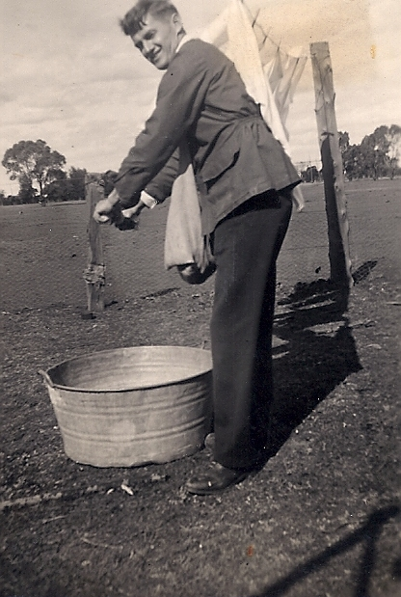
Notes:
Clive and Nancy were engaged for two years before they married. Clive demonstrated his domestic skills during a visit to Niloc, Nancy’s mother’s property near Tottenham in outback western New South Wales. Nancy and her mother Viola were evidently watching and having a big chuckle at Clive’s laundry efforts.

Slide 16
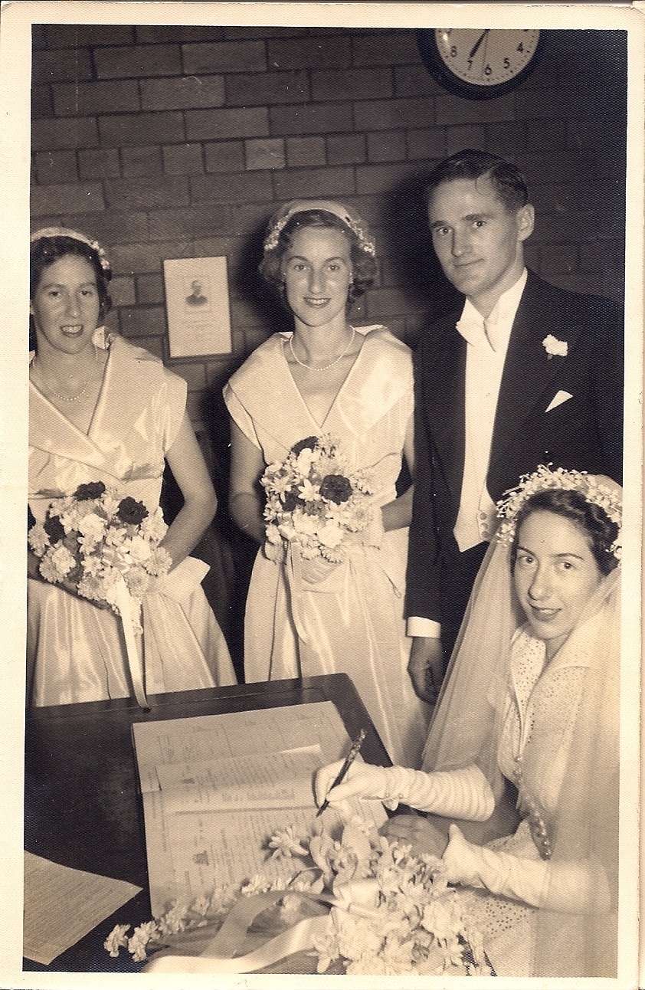
Notes:
Clive and Nancy’s wedding. 24 March 1951, three days before Clive’s 26th birthday.
From left: Nancy’s sister June, Clive’s sister Beth, Clive and Nancy.
Nancy’s broderie anglaise dress had been made by her mother-in-law to-be Winifred Henderson.

Slide 17
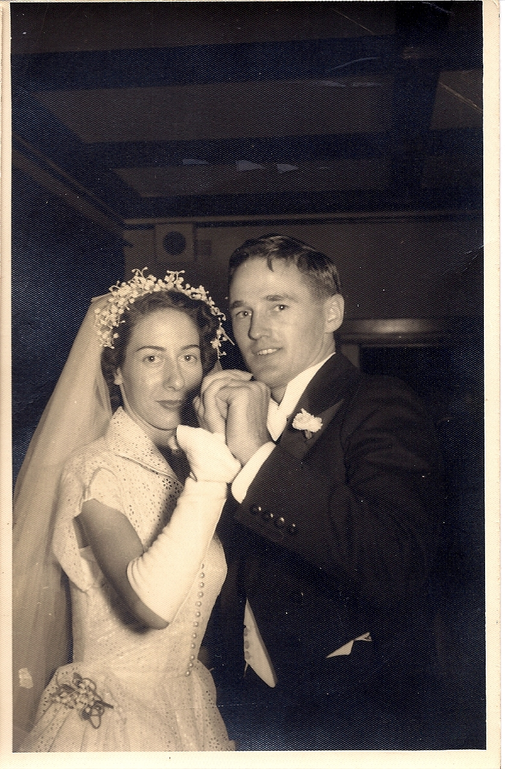
Notes:
The wedding waltz.

Slide 18
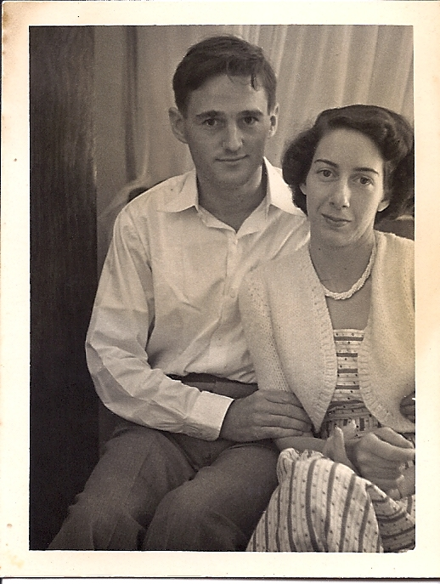
Notes:
Clive and Nancy drove from Sydney to their honeymoon at Broadbeach, Gold Coast, Queensland.
While there, Clive set up the tripod, camera and self-timer.
We feel you looking into the future at us. Meanwhile, we’re looking at you, beloved parents, experiencing how beautiful, how loving, how resolute you are and will be.

Slide 19
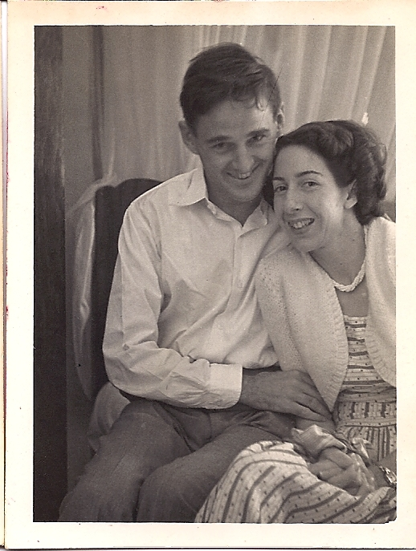
Notes:
Clive and Nancy, honeymoon.

Slide 20
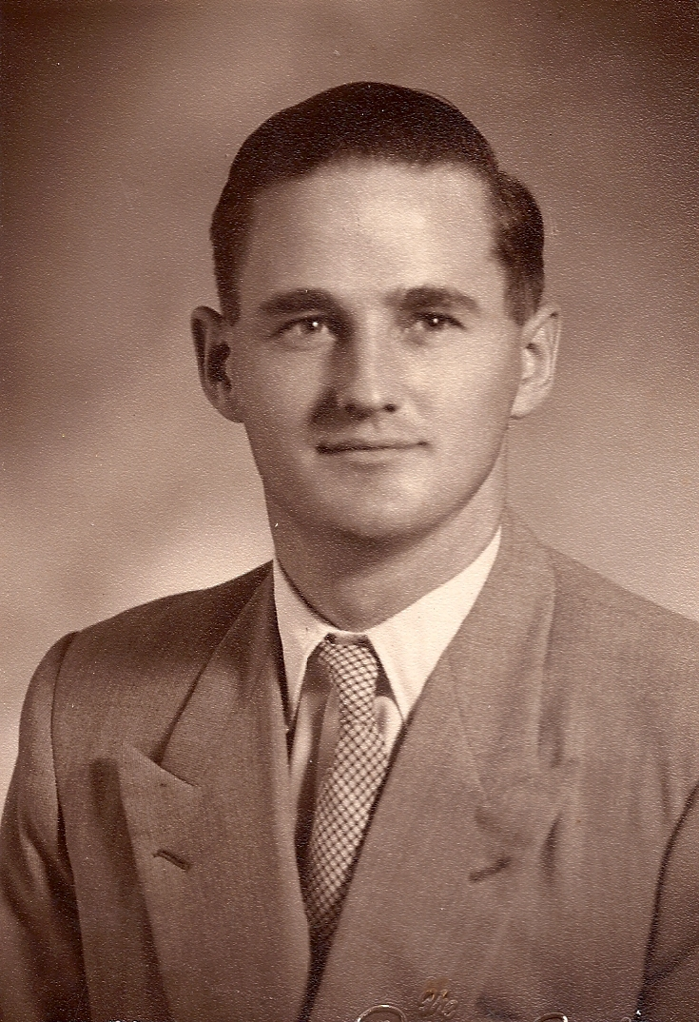
Notes:
Studio portrait taken for Clive’s passport.

Slide 21
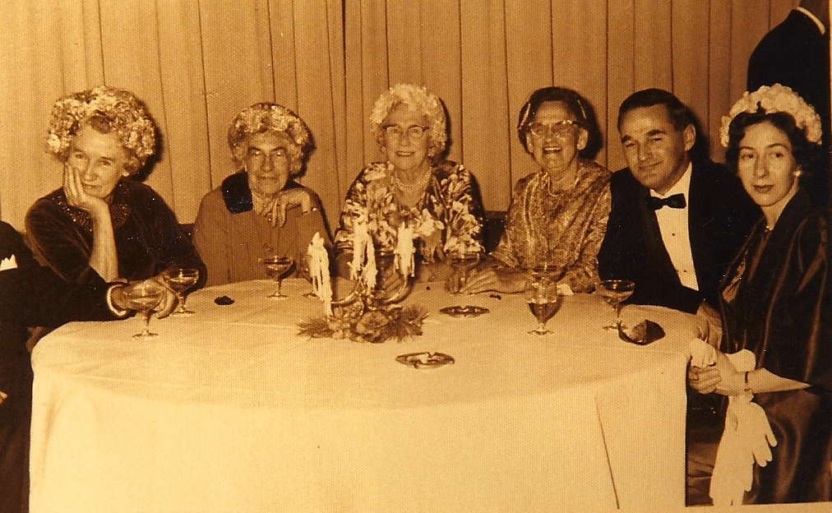
Notes:
An important family event during the 1960s. From left: Clive’s Aunty Edna (wife of Clive’s Uncle Jack), Viola (Nancy’s mother), Winifred (Clive’s mother), Aunty Isobel (Winifred’s sister), and Clive and Nancy.
Thinking back, this event may have been the wedding of Edna and Jack’s daughter Diane to Lachlan Carnegie. If so, this was 1963 and Nancy and Clive’s daughters Chris and Sue were flower girls aged, respectively, ten and seven.

Slide 22
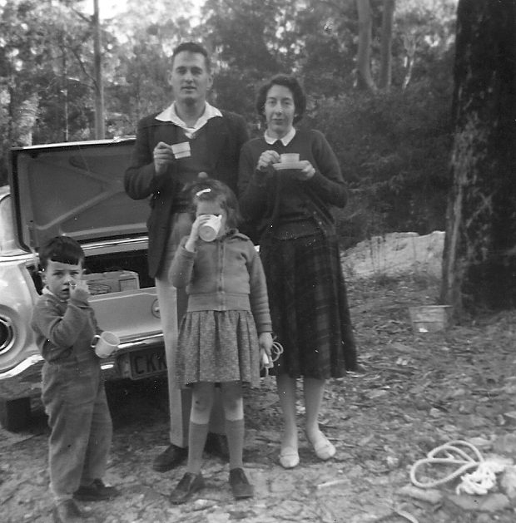
Notes:
Family picnic in the bush. This was a frequent Sunday delight to get out, boil the billy, play games and go for a walk.

Slide 23
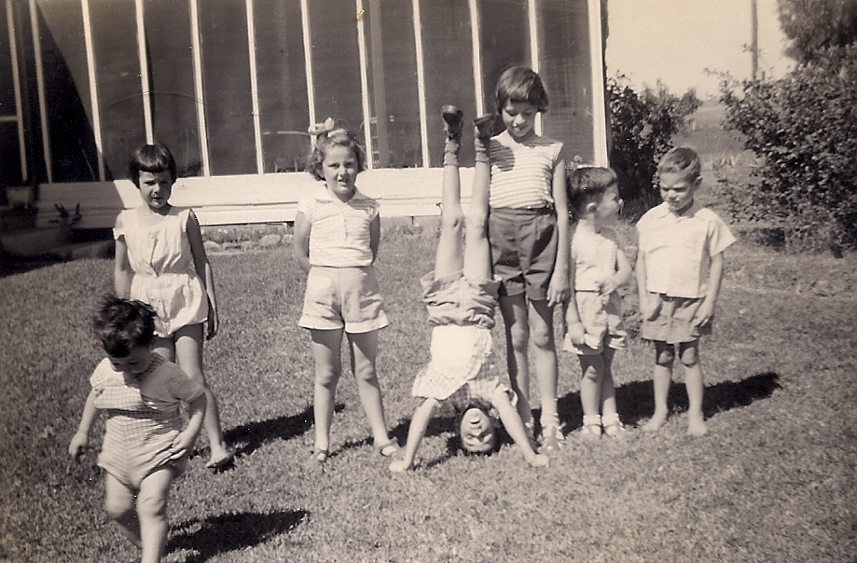
Notes:
Visiting our country cousins at Tarcutta, children of Nancy’s sister June and her husband John. Dad would have taken the photograph. Era: early 1960s?
From left: Ross (heading out of the photo), Lyndal, Sue, Colin (headstand), Chris, David and Hartley.

Slide 24
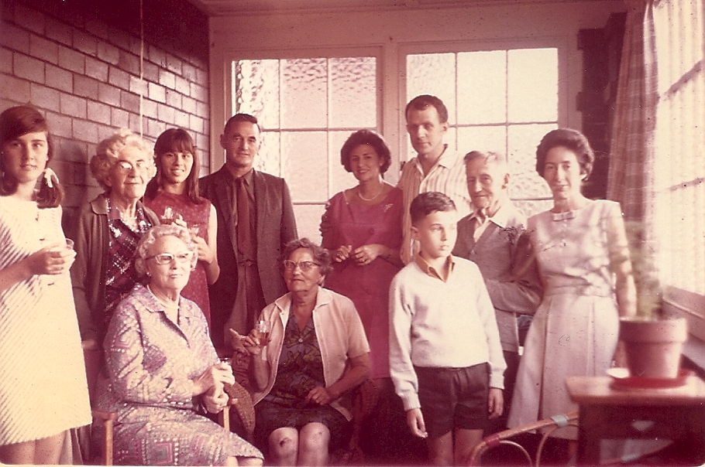
Notes:
A gathering at the house of Clive’s Aunt Isobel and Uncle Arthur’s house at 9 Neridah Street Chatswood in Sydney. The year – possibly around 1968.
All important family gatherings took place there at Neridah Street.
From left, standing: Sue, Nana (Vi Richardson, Nancy’s mother), Chris, Clive, Clive’s cousin Diane and her husband Lachlan, David, Uncle Arthur, and Nancy.
Sitting: Grandma, Great Aunty Bel.

Slide 25
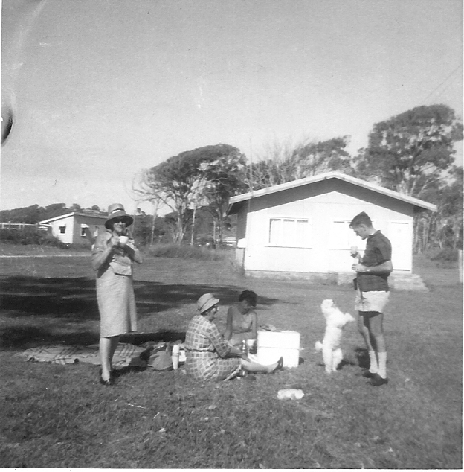
Notes:
A family picnic, probably in the mid 1960s.
From left: Clive’s mother Winifred, his Aunty Bel (Winifred’s sister), Nancy, Gigi the poodle and Clive.

Slide 26
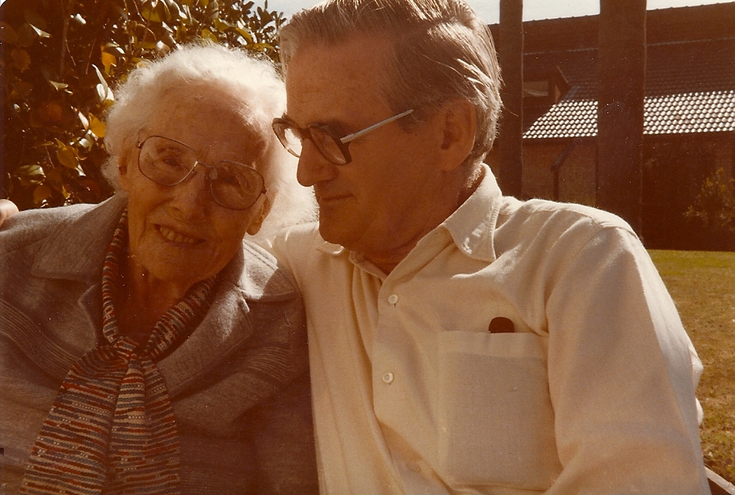
Notes:
Clive with his mum Winifred.

Slide 27
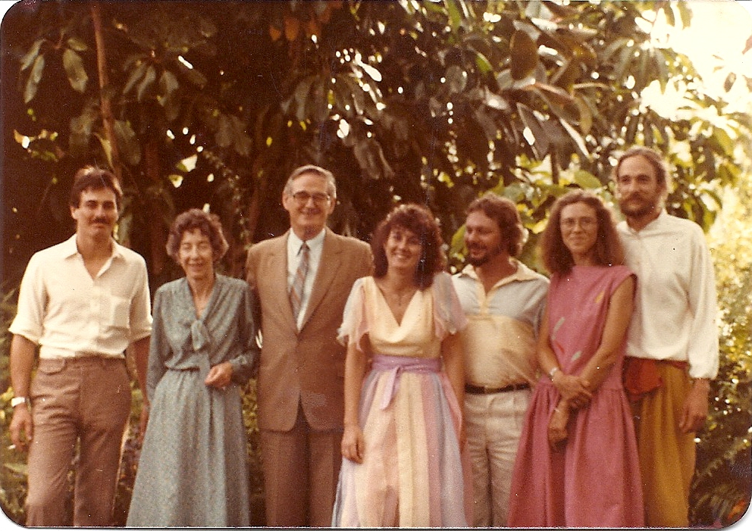
Notes:
Back home after Sue’s wedding to Sandy. Sue had designed and made the outfits for herself, Chris, Keith and Mum.

Slide 28
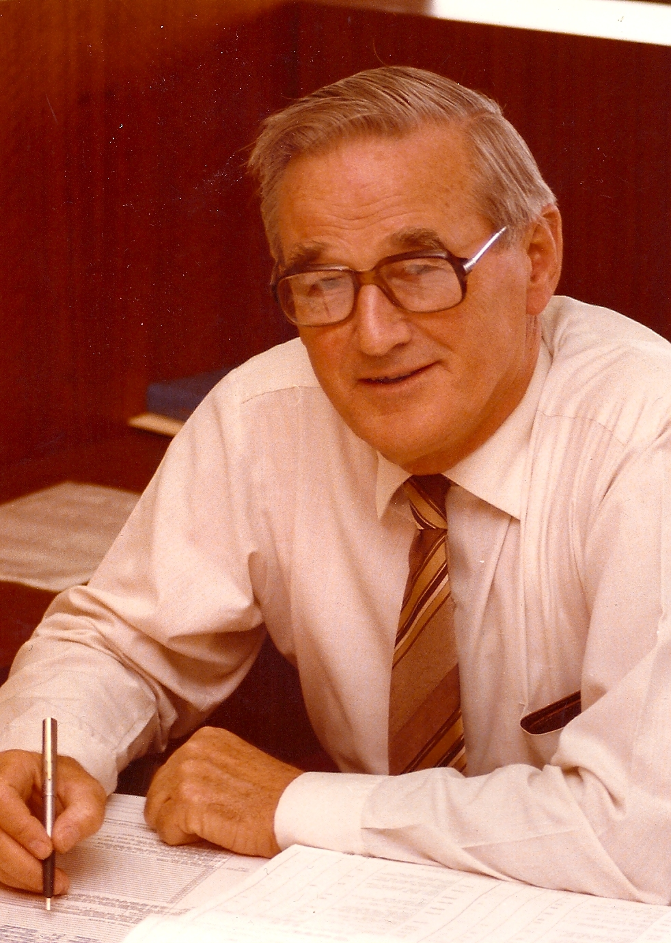
Notes:
Clive at work.

Slide 29
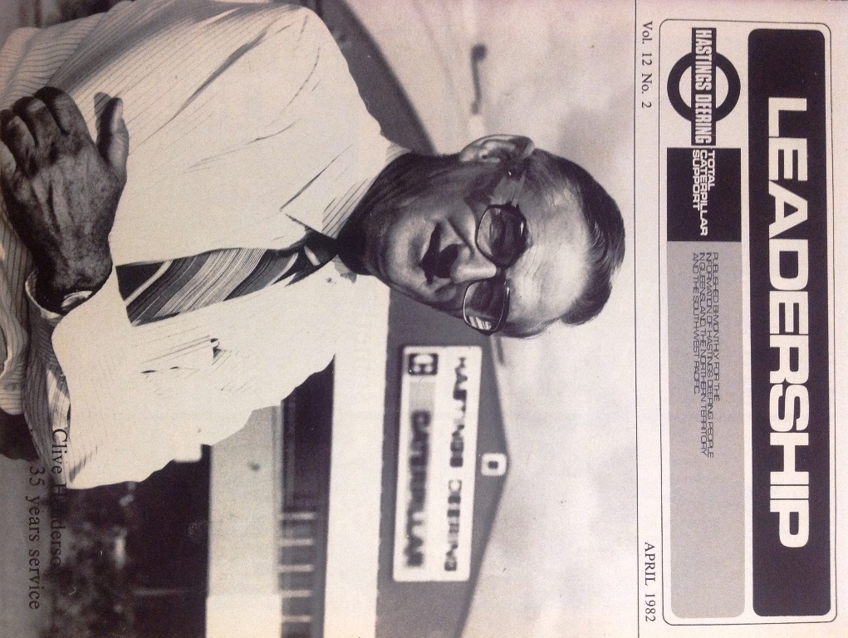
Notes:
Clive outside the Hastings Deering hanger at Kerry Road, Archerfield, Brisbane.

Slide 30
Notes:
Article in the Hastings Deering ‘Leadership’ magazine about Clive’s 35 years of service.

Slide 31
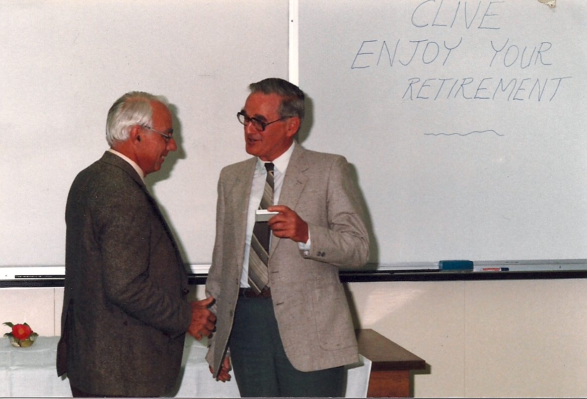
Notes:
Clive’s retirement from Hastings Deering.

Slide 32
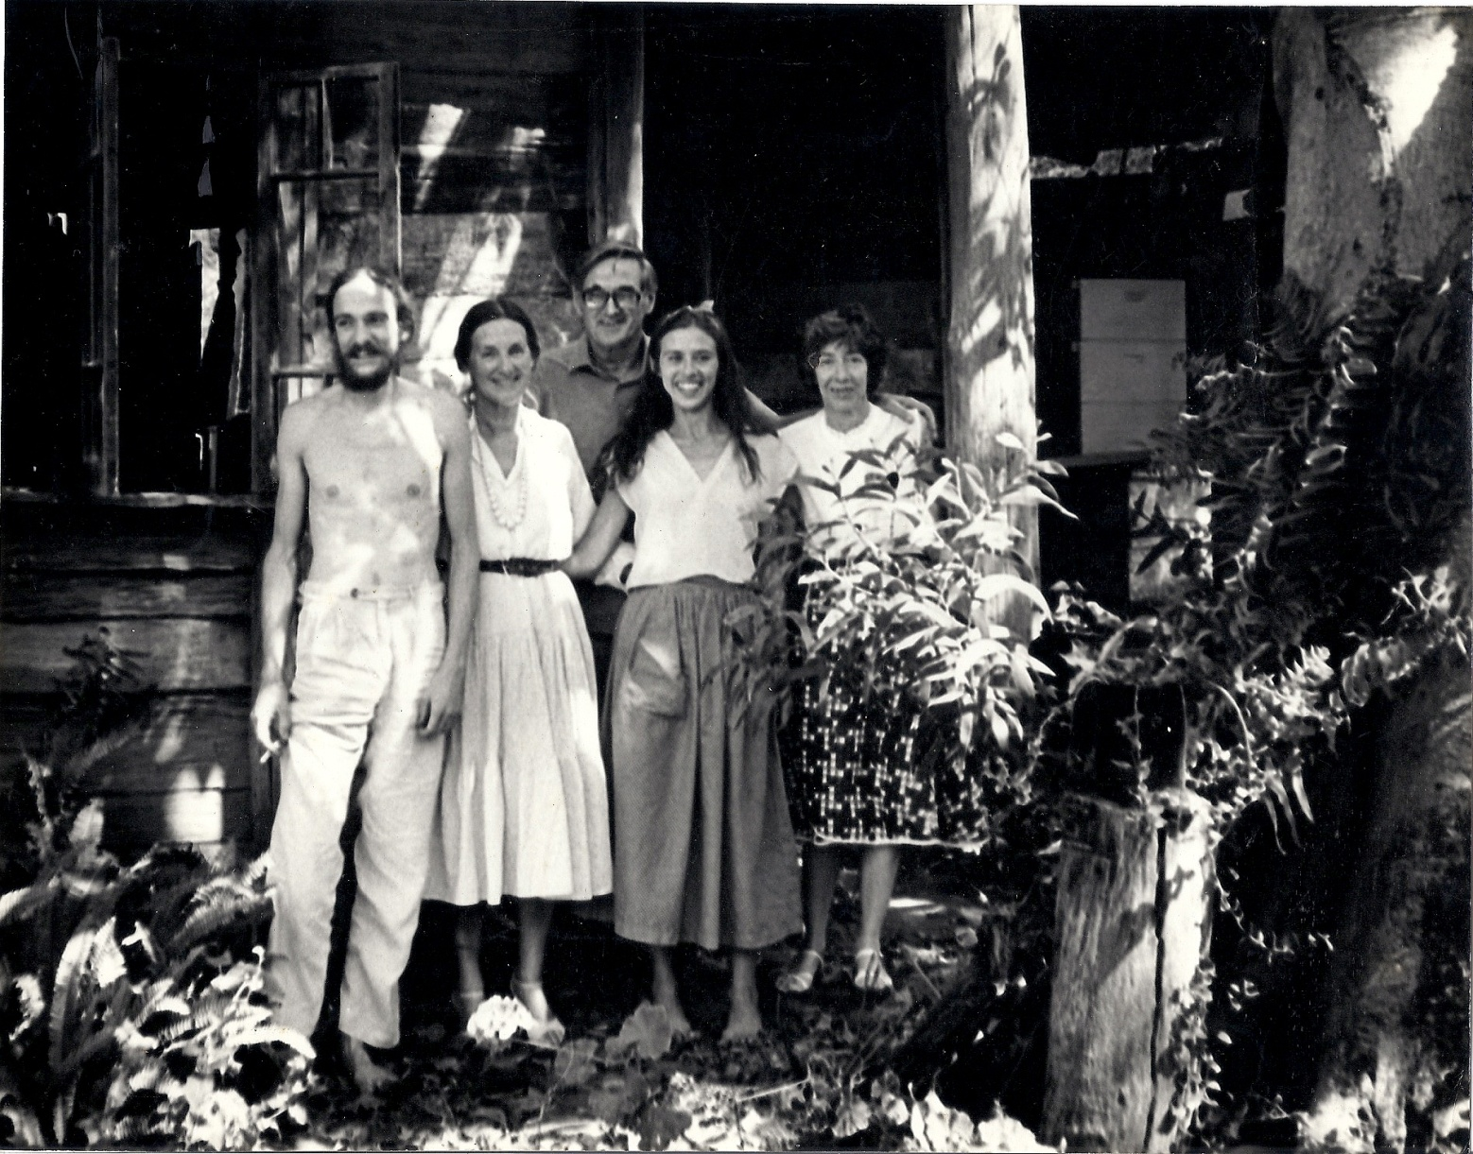
Notes:
Clive and Nan brought Beth for a visit to the old slab wood house near Fernvale, Queensland, where Chris and Keith lived for around eight years from 1977. A beautiful day and strong sense of connection.

Slide 33
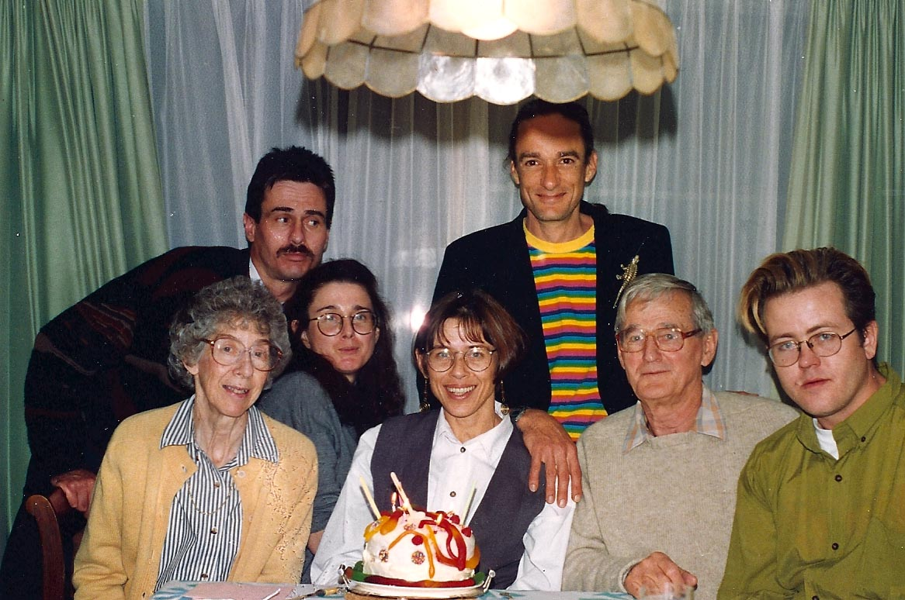
Notes:
Chris’ 40th birthday in 1993 with cake made by Sue.
From left: Nancy, Dave, Sue, Chris, Keith, Clive and Peter (Sue’s partner at the time and still a very good friend of Sue’s and the family).

Slide 34
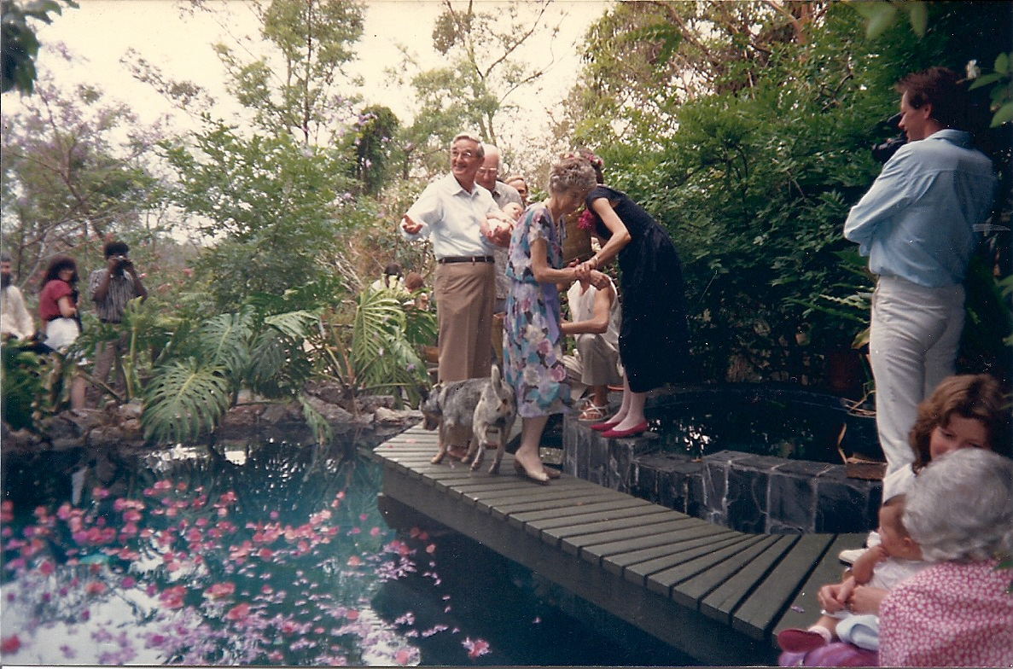
Notes:
4 November 1989. Chris and Keith’s wedding which took place at a friend’s backyard pool. The ceremony ended with guests sprinkling bougainvillea and jacaranda flowers into the pool and sending best wishes. Radar the cattle dog was best man with a bow-tie. Mum had just sprinkled a handful of petals and Dad is now having a turn.

Slide 35
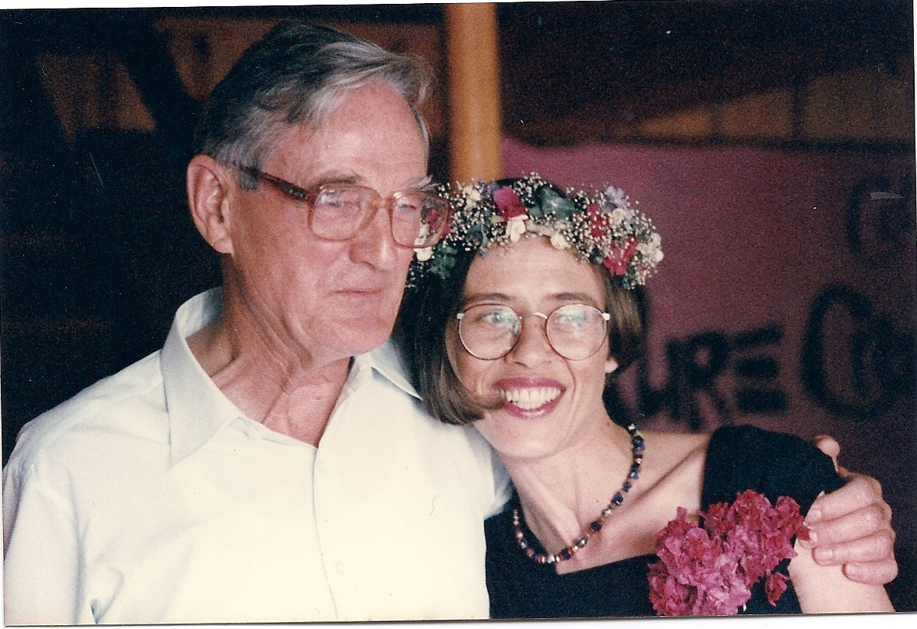
Notes:
Clive and Chris.

Slide 36
Notes:
Clive with his tripod. Photography was an ongoing interest in his life, for recording the family and events.

Slide 37
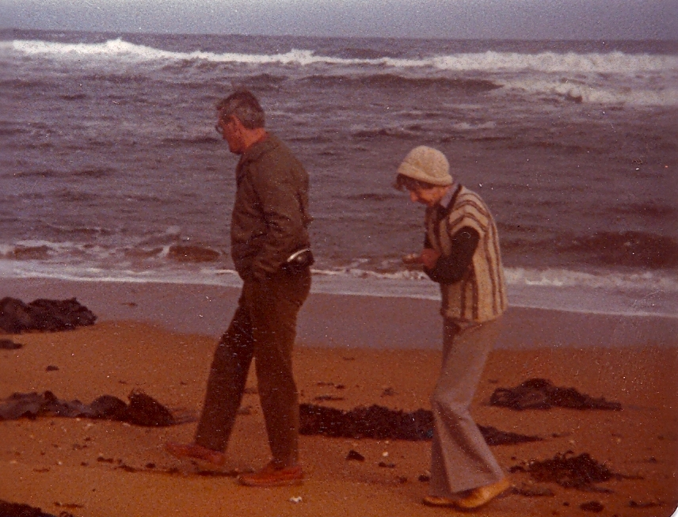
Notes:
Clive and Nancy holidaying at the beach in winter.

Slide 38
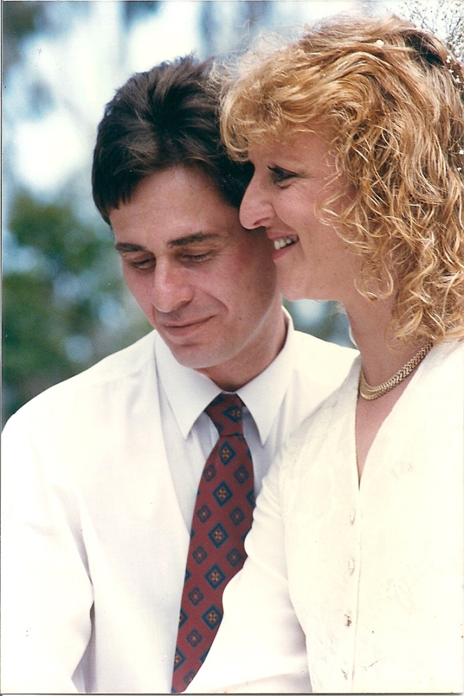
Notes:
David married Trish Borsboom on 9 September 1994.

Slide 39
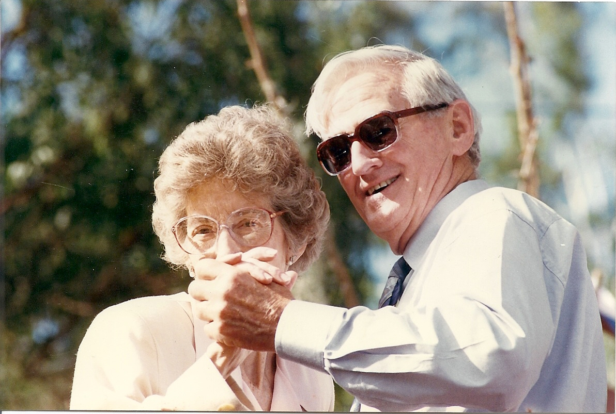
Notes:
Nancy and Clive dance at Dave and Trish’s wedding.

Slide 40
Notes:
Nancy and Clive dance at Dave and Trish’s wedding.

Slide 41
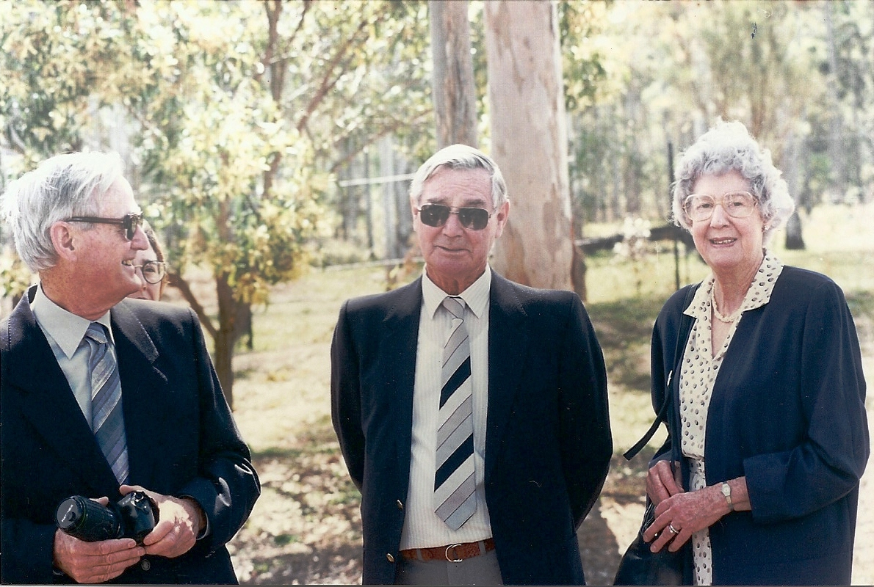
Notes:
Clive, brother-in-law John and John’s wife June (Nancy’s sister) at Dave and Trish’s wedding.

Slide 42
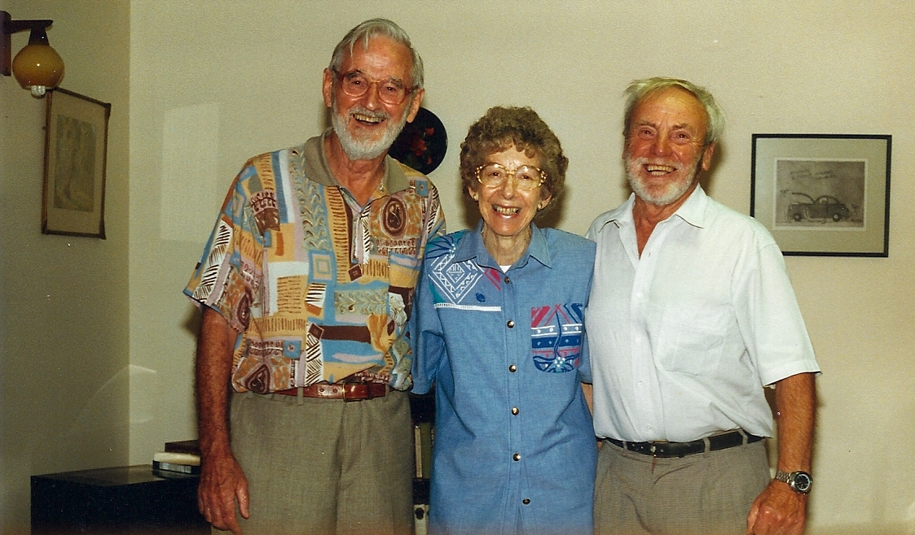
Notes:
Clive and Nancy catch up again with Clive’s longtime Air Force friend Peter Clements, and as always share so many laughs and smiles.

Slide 43
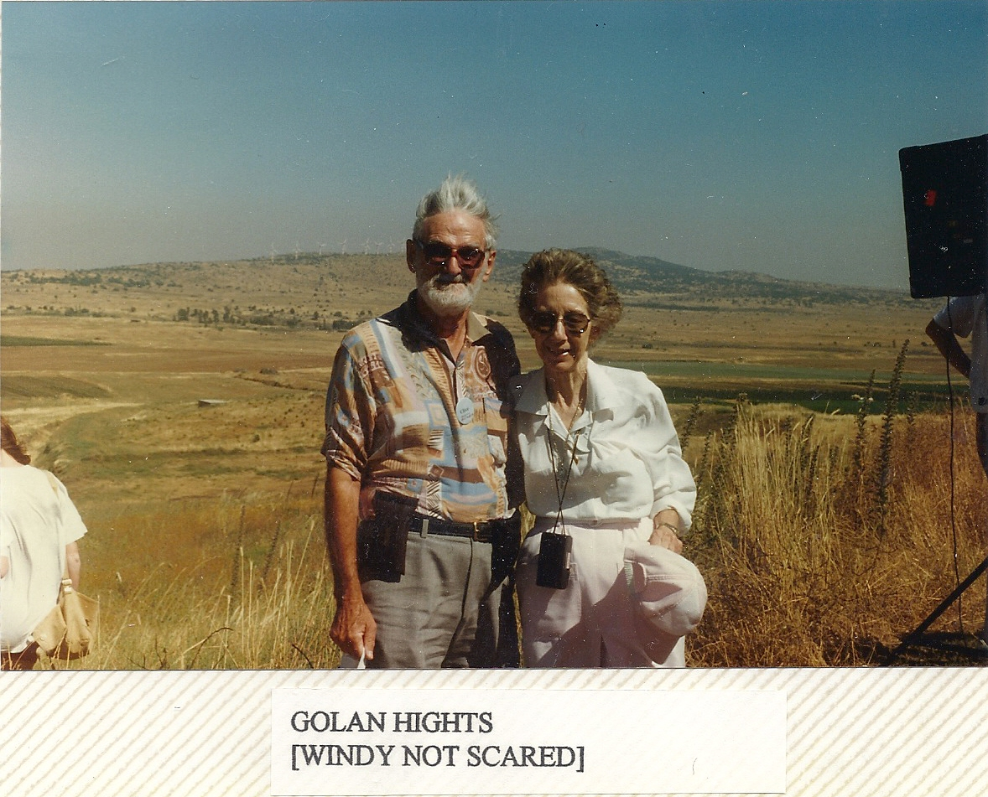
Notes:
Clive and Nancy’s trip to Europe and Israel. Clive’s sense of humour shows through in the caption.

Slide 44
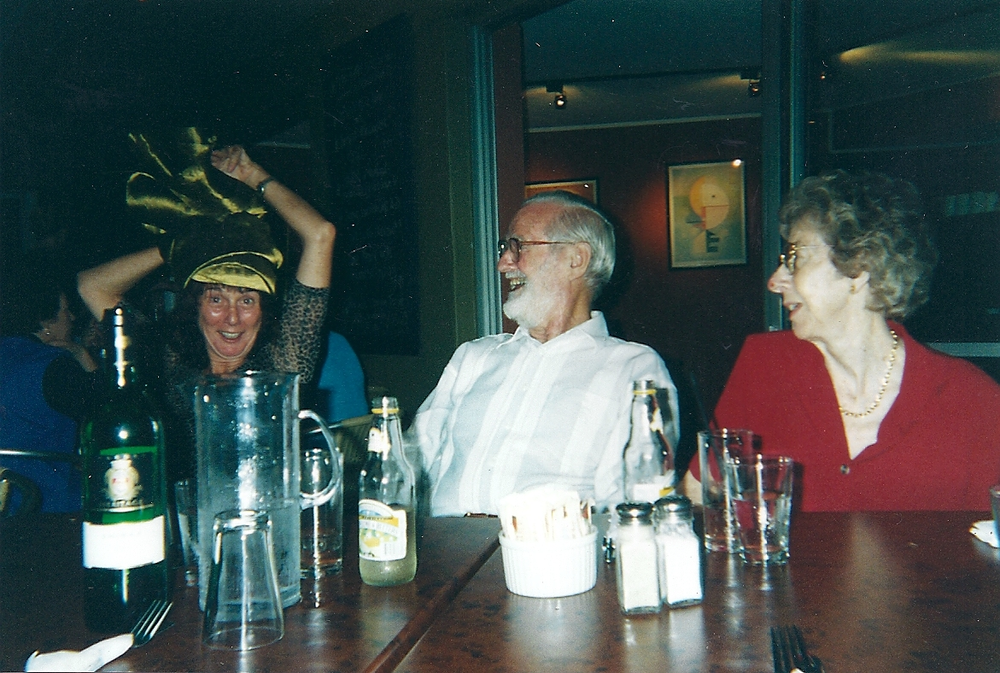
Notes:
Sue demonstrating a funny hat. Clive and Nancy have been wonderful in encouraging and supporting their grown-up children in their various adventures and professions over the years.

Slide 45
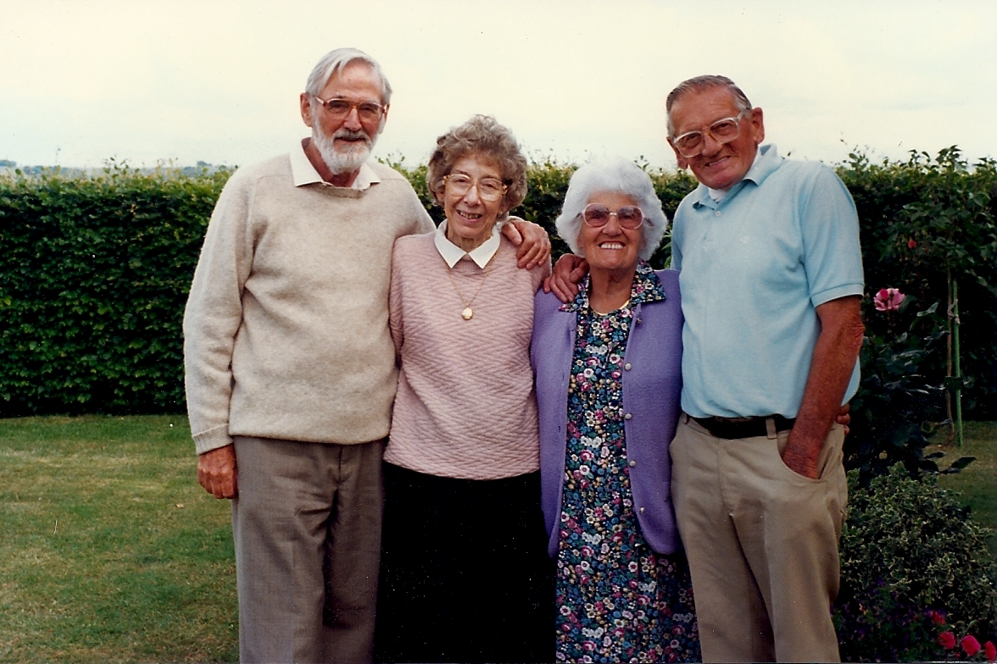
Notes:
Clive and Nancy with the dear parents of pastor friends. Mum and Dad had visited these lovely people in England and they had all remained firm friends.

Slide 46
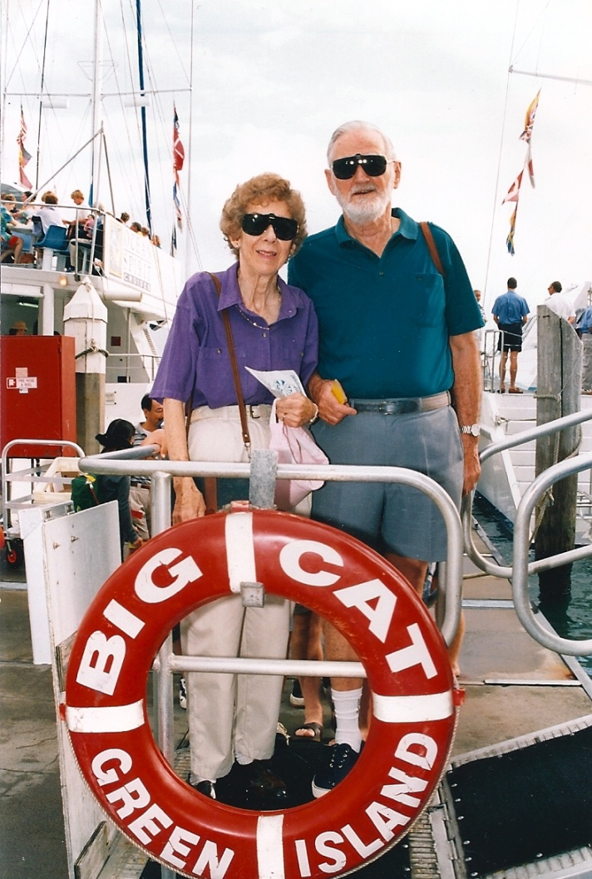
Notes:
Nancy and Clive holidaying in North Queensland.

Slide 47
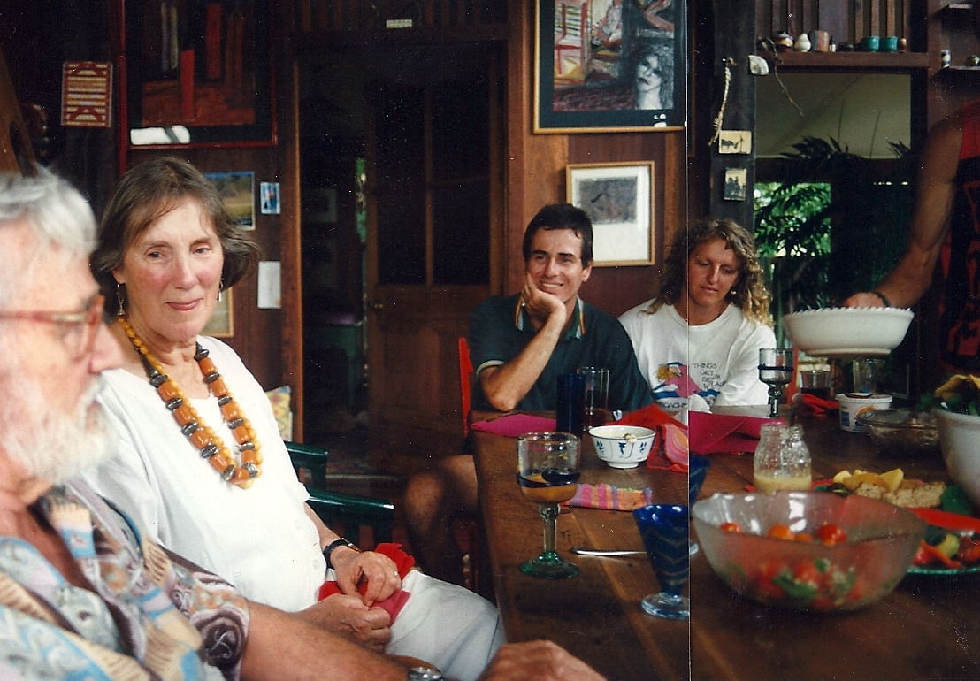
Notes:
Clive, Beth, Dave and Trish at the Flaxton (Sunshine Coast hinterland) property where Keith helped to build the house and then set up a chilli farm, and where Chris and Keith lived for a while. Possibly 1994.

Slide 48
Notes:
Dad had made a home-made clarinet from a piece of plumbing pipe, as an experiment, after Nancy had brought a cheap one home from Kiev. Grandson Cameron really wanted to have one too. Dad surprised him by making and giving him his very own for Christmas. Cameron still remembers that he was over the moon with delight, and hadn’t expected it to happen.
For a little while Dad did actually persevere in teaching himself to play, then moved on to other more practical activities.

Slide 49
Notes:
Dress ups and so much fun with granddaughter Carly.
1995 at Goodwood?

Slide 50
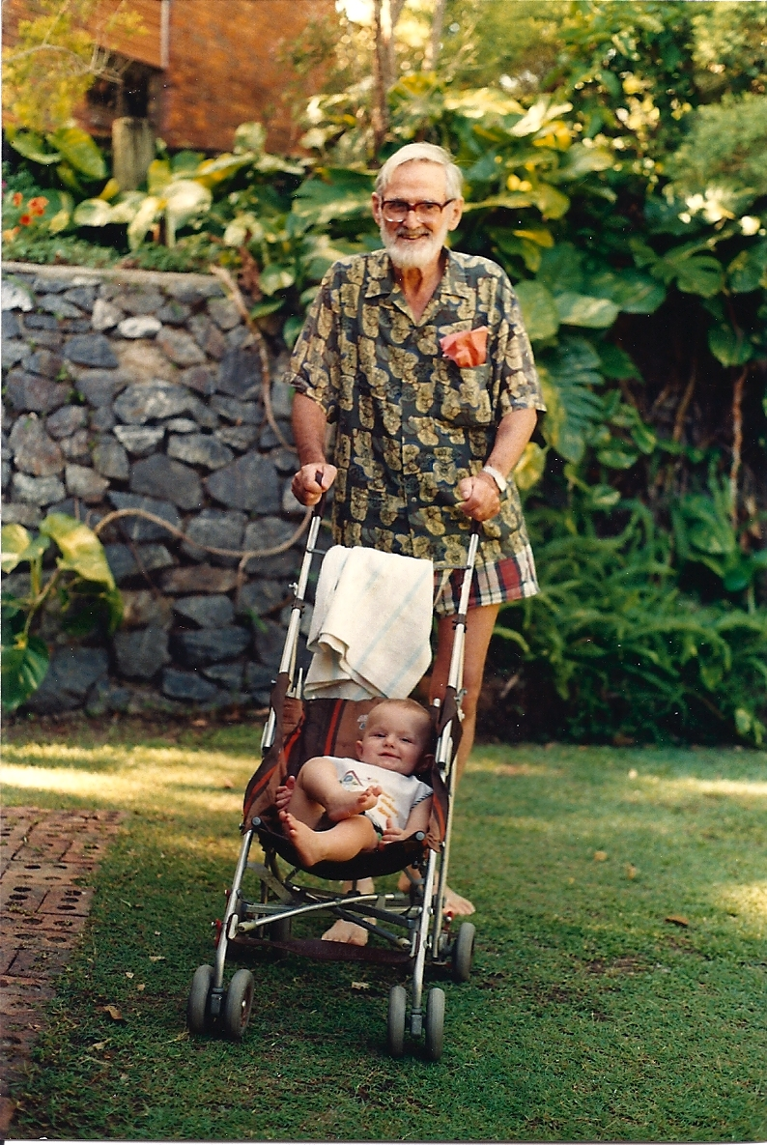
Notes:
Dad, loving being a grandfather as he looks after Zach at their home. Zach was born on 8 May 1996, so maybe this was taken late 1996?.

Slide 51
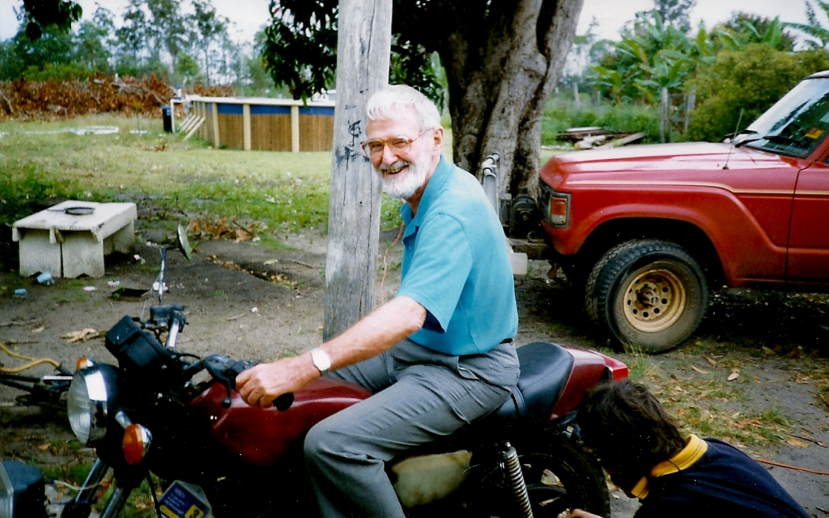
Notes:
Dad in the hot seat. Was that one of Dave’s bikes?

Slide 52
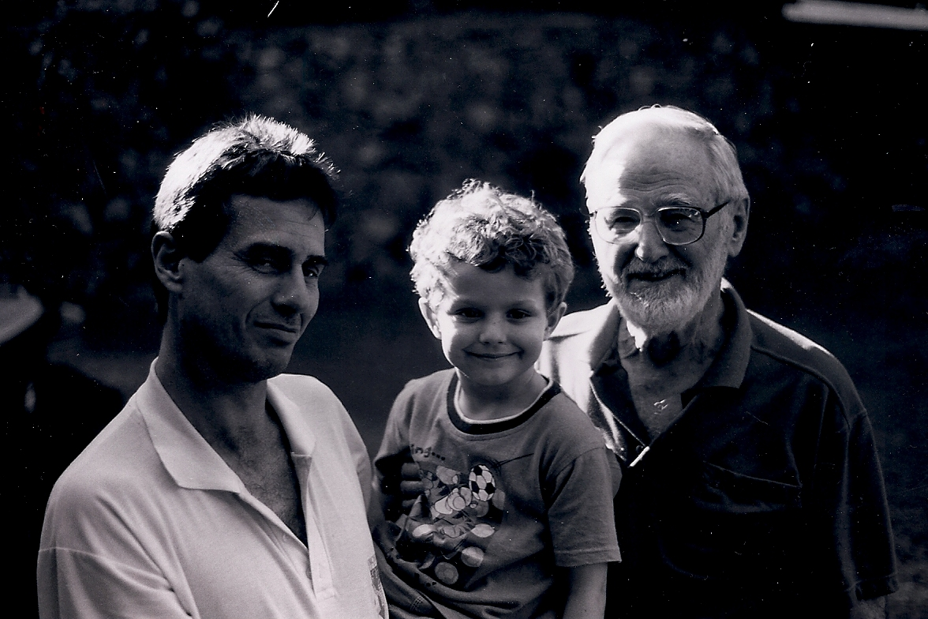
Notes:
Dave, Zach and Dad. This b&w and the colour photos were taken around September 1999, some six months before Dave died on 2 March 2000. These are the only photos we have of the three generations of males together – which also means three Rainsfords together!
Dad’s, Dave’s and Zach’s middle name is Rainsford. The tradition has come down from the first boy in each generation of Dad’s family.
Judy Henderson, one of Clive’s cousins, has said there are now (2012) just two Henderson boys in this part of the Henderson clan to ‘carry on the name’. Zach is one of them.

Slide 53
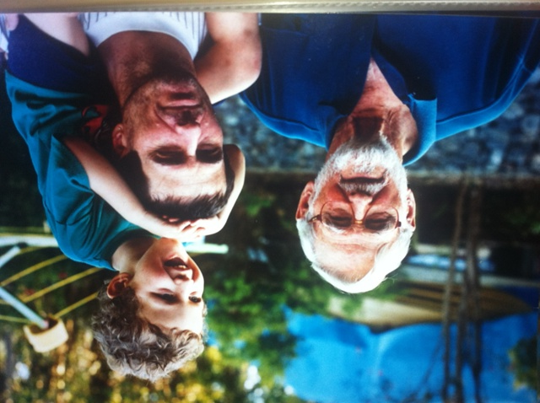
Notes:
Clive, David and Zach again.

Slide 54
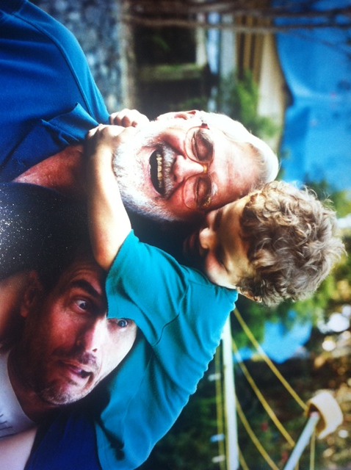
Notes:
The three generations show their love of fun, laughter, clowning around – and each other.

Slide 55
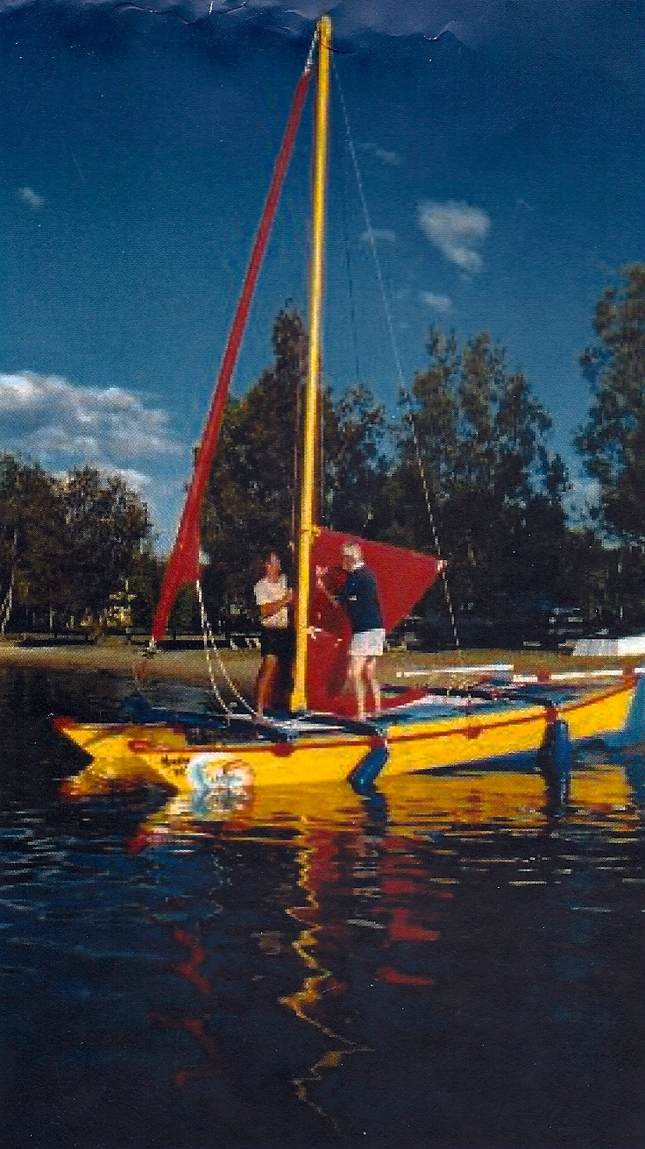
Notes:
Clive and Sue set up for a sail on Sue and Tarci’s boat Monkeyme.

Slide 56
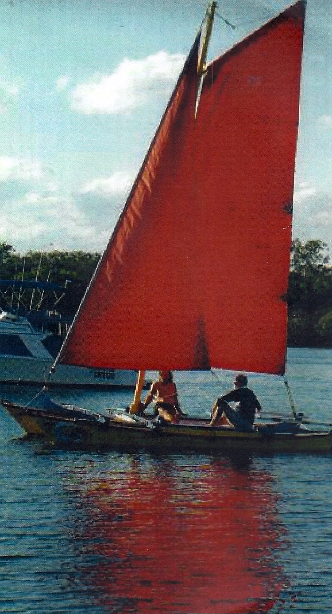
Notes:
Sue and Clive on Monkeyme.

Slide 57
Notes:
Nancy and Clive, early 2000, not long after their son David had died in a motorcycle accident.

Slide 58
Notes:
Late March or early April 2000 at Trish’s place. Son-in-law Keith is in the background.

Slide 59
Notes:
Beth visits Brisbane. From the length of Tarci’s beard, Sue worked out that Tarci and Sue had recently returned from their big adventure sailing up the Queensland coast on their little Monkey Me, a sixteen-foot islander-style catamaran (Warrum).
Around 2003?

Slide 60
Notes:
From left: Chris, Zach, Cassie and Trish.
Asked about his special memories of Grandpa, Zach immediately said playing ball and playing games in the back yard.
While Clive is not in the photo, he would have been close by as the family played boule in the back yard on Boxing Day 2003. And very possibly he took this photo.

Slide 61
Notes:
Dad’s eightieth birthday. Held at the Gardens Café, Mt Coot-tha Botanical Gardens, Brisbane. A really beautiful celebration, location and afternoon.
27 March 2004
From left: Mimi (Keith’s mum), Nancy, Clive and Sue. And the fabulous cake.

Slide 62
Notes:
Dad’s eightieth birthday on 27 March 2004. Great location at the Brisbane Mt Coot-tha Botanic Gardens restaurant.
From left: Mimi (Keith’s mother), Nancy and Clive, Sue and Tarci, Zach (who took the photo!), Josh (former partner of Cassie), Cassie, Trish, Keith and Chris. And out of sight next to Mimi is Emily, daughter of Cassie and Josh and the very new addition to the family.
Zach set up and took this photo.

Slide 63
Notes:
May 2004. Proud grandparents.

Slide 64
Notes:
May 2004. Dad relaxing at Trish’s place.

Slide 65
Notes:
Dad loved having his family around, and there was usually a warm laugh close by as well. This time, in Trish’s back yard.
25 July 2004.

Slide 66
Notes:
Keith, Clive and Zach.
25 July 2004.

Slide 67
Notes:
A relaxed lunch on the back verandah with Nan’s sister June and her husband John from Wagga Wagga in southern central NSW.
May 2004.

Slide 68
Notes:
16 May 2005. Clive and Nancy, and Nancy’s sister June with her husband John.

Slide 69
Notes:
May 2005. Watching Carly, the daughter of Clive and Nan’s nephew Colin, playing a tournament.
Back, standing: Clive, Colin (June and John’s eldest) and John.
Sitting: Nancy, Chris, June.

Slide 70
Notes:
23-25 December 2004.
The garden steps needed levelling and a railing added to improve safety for both Mum and Dad. Sue and Tarci did the job – with Dad involved and helping hands-on as much as he could even though the weather was very hot and humid and the idea – well, at least for the rest of us - was that Dad would stay in the shade and supervise. It was clearly hard to keep a good man down though!

Slide 71
Notes:
Close to finished.

Slide 72
Notes:
Sue and Tarci – yes, and Clive – are just about finished redoing Nan and Clive’s front garden steps. The idea was that Clive was to sit back while the work was done. Not much chance!!

Slide 73
Notes:
June 2005: a 41st reunion of three families of school friends. The Hendersons, Stewarts and Herons first met in 1964 when Nancy and Clive moved back to Brisbane from Sydney and enrolled the three children at the local Kenmore Primary School. With three children in each family, and children approximately the same ages, the friendships continued through primary school and beyond.

Slide 74
Notes:
Clive and Nancy in Europe on their way to England.

Slide 75
Notes:
Clive and Nancy fulfil a dream: a biblical tour of Israel.

Slide 76
Notes:
Clive at the Dead Sea.

Slide 77
Notes:
In 1945, just weeks before the end of WWII, an aircraft piloted by Nancy’s brother F/O Colin Richardson crash-landed at Foxton, England after a bombing raid over Germany. All on board perished however, amazingly, no local residents were injured and no buildings were damaged. The crash had been officially recorded as pilot error, however some of the information seemed to suggest otherwise.
In the late 1990s, Clive focused his passion, doggedness and increasing internet skills on a research project to unearth the real story behind the crash on behalf of Colin and the families of the other airmen – with beautiful results for those involved.
Some Foxton residents had also been trying to trace the relatives.
In June 2000, Clive and Nancy visited Foxton during a trip to England. For both Clive and Nan this was the start of very special connections and deep and lasting friendships with the Foxton community and the families of the other airmen.
Local residents decided to erect a memorial in honour of those killed. The plaque above was unveiled on 9th April 2002, the 57th anniversary of the crash. Those gathered included Foxton residents, relatives of the crew - including Clive and Nancy who travelled to England for the event - and a representative of the Australian High Commission.
Clive and Nancy have always been gentle, caring people who work quietly in the background for what they believed in and avoid publicity of any sort. Here they were involved in seeking truth and justice and bringing peace and acknowledgment to the families of the lost airmen and thanks to the Foxton community. So it was an enormous shock for them to them that the little unveiling of the plaque at Foxton - and the associated story of this community’s connection with airmen and families from Australia and Canada - was receiving national coverage through the BBC news, even receiving given top status and being broadcast many times over, alongside with the Queen’s Jubilee celebrations happening that same weekend!
The bonds between Clive and Nan, the Foxton community and the families of the other airmen have continued and grown over the years into deep lasting friendships, mostly sustained through email.
Clive’s research was critical in unearthing the real story. We know that he was pleased with his contribution. If you’d like to know more, search ‘Foxton not Folkstone’ on the internet. This is an article in the BBC Air Force archives which includes an email that Clive wrote summarising his research. (http://www.bbc.co.uk/history/ww2peopleswar/stories/99/a6281499.shtml. Clive’s information is also provided at http://www.britishlegion.org.uk/media/1174663/Lancaster_ND_949__more_info.pdf)
Note. This was the second of Clive’s major historical research projects. The other, begun in 2000, researched the history of both his own forbears and also Nancy’s. Once again, Clive’s careful research methodology unearthed important information and insights which have been appreciated by others.

Slide 78
Notes:
Foxton, England. Clive and Nancy with the Foxton Church plaque in memory of Colin Richardson and the six other crew members of their RAF plane.

Slide 79
Notes:
Clive and Nancy stand underneath a Lancaster with friends they made through Clive’s Foxton research project. This was at the East Kirby RAF airbase at Lincolnshire where Colin had been stationed.

Slide 80
Notes:
December 2004.
Clive and Nancy with Chris and Keith, Tarci and Sue at Gardenway café, Brisbane. Good catch-up time, plus a chance for Nancy and the younger ones to look at plants.

Slide 81
Notes:
Nancy’s 80th birthday, held at a local restaurant Kis Cucina. A lovely afternoon.
13 February 2007.
From left, back row: Trish, Emily (Cassie’s daughter), Zach, Keith, Josh (Carly’s boyfriend at the time).
Second row, standing: Clive, Carly, Nancy, Mimi (Keith’s mother).
Sitting: Chris, Tarci, Sue.

Slide 82
Notes:
13 February 2007. Nancy, Zach and Clive.

Slide 83
Notes:
13 February 2007. Nancy, Trish and Clive.

Slide 84
Notes:
8 November 2008.

Slide 85
Notes:
Trish and Clive at Trish’s wedding to Brad Hines at Ipswich, Queensland on 8 November 2008.
Clive was so honoured, delighted and moved to be asked to give Trish away – and then very concerned that he wouldn’t be able to do so as he’d broken his elbow very badly in a fall and had his arm in a sling.
Of course Trish wouldn’t allow the damaged elbow to get in the way. The rest of that story is history.

Slide 86
Notes:
Nancy and Clive at the reception after Trish and Brad’s wedding.

Slide 87
Notes:
Christmas Day 2008.
Back row: Brad (Carly’s then boyfriend), Carly, Trish, Sue, Brad, Tarci.
Middle row: Nancy and Clive.
Front row: Zach, Keith, Chris.

Slide 88
Notes:
February 2009. A hot dry day.
This was a trip to a farm in the Lockyer Valley in south-east Queensland, an hour or so away from home, and definitely worth the trip.
The farmer and his wife have long been avid researchers, collectors and users of vintage Caterpillar tractors and memorabilia, as well as collectors of the immediate precursors to Caterpillar. This, their private museum and labour of love, is a huge collection and well cared for with almost every one of the tractors in working condition.
There were dozens of visitors, some young, mostly older.
For Clive, it was an especially memorable event as, in addition to his love for Caterpillar tractors, the farm is situated in the region where he had had closest connections through his decades as Hastings Deering Sales Manager for local government and agricultural sales. So the day provided a good time for both reflection and making new friends with the farmer and others.

Slide 89
Notes:
In front of the Caterpillar 2 Ton. Caterpillar tractors had formed the work focus for Dad since the end of WWII, and his interest continued on after his retirement.

Slide 91
Notes:
A chance to drive one!
The Caterpillar 60 was a 60 horsepower (45 kW) crawler tractor manufactured by the Caterpillar Tractor Company from 1925 until 1931. It was the largest tractor in Caterpillar’s product line at the time.
Back in his early years with Hasting Deering, tractors first arrived in Sydney, then needed to be transported around the country. Clive recalled driving one – a smaller one than this 60 – from Sydney to Melbourne. A long trip.

Slide 92
Notes:
Skills remembered. Having a great time.

Slide 93
Notes:
A big fella, this machine Clive is driving.

Slide 94
Notes:
Examining the very old “Hy-Way Scarifier Grader” manufactured by Eustace Holliday, Sydney.

Slide 95
Notes:
Christmas Day 2011.
Ever since we can remember, Dad has measured the heights of children and grandchildren on the kitchen pantry door. He hadn’t recorded Zach’s height for a while though – and looks as though he has met his match here!! A ladder, anyone? Zach meanwhile is delighted by his lofty heights – and so is his Grandpa.

Slide 96
Notes:
With their usual sense of fun, equality and inclusivity, Zach and Dad then looked at how to make the height differences a little more even for the photograph! The flowers were Zach’s gift to Grandpa and Grandma.

Slide 97
Notes:
27 February 2012. Keith had just been released from hospital for a few days after his first round of chemotherapy. Since Keith’s diagnosis with acute myeloid leukaemia, Dad had followed the ‘Friends’ blog (www.chrisandkeith.wordpress.com) religiously every day to read how Keith was faring, and to print the info out for Mum to read.
Dad was thrilled and very moved to see Keith in person.
He’d shaved his beard off in solidarity with Keith until his Keith’s hair grew back, and as an early indicator of support for the Leukaemia Foundation’s Shave for a Cure national fund raising event scheduled for mid-March.
(At the end of 2012, Keith is in remission, free of leukaemia. Dad ws so pleased to hear this and to join in the assertion that the leukaemia has gone forever, which it has.)

Slide 98
Notes:
Granddaughter Cassie with great-grandchildren Emily and Lachlan. This was during Clive’s third last week. He appreciated family visits.
Emily had been born just before Dad’s eightieth birthday and attended the 80th birthday celebration in a pram.

Slide 99
Notes:
Our beautiful Clive. A photo taken not so long ago with Keith in the background.

